Slide 1
Disk Management (W. Stallings, ch-11)
Notes:
These slides are intended to help a teacher develop a presentation. This PowerPoint covers the entire chapter and includes too many slides for a single delivery. Professors are encouraged to adapt this presentation in ways which are best suited for their students and environment.

Slide 2
Roadmap
Disk Structure
Disk Scheduling
Disk Reliability
Disk Formatting
Boot Block
Bad Block
Notes:
Beginning with a brief discussion of I/O devices and the organization of the I/O functions.
Next examine operating system design issues, including design objectives, and the way in which the I/O function can be structured.
Then I/O buffering is examined;
The next sections of the chapter are devoted to magnetic disk I/O.
We begin by developing a model of disk I/O performance and then examine several techniques that can be used to enhance performance.

Slide 3
Magnetic Disk Structure
Traditional magnetic disks have the following basic structure:
One or more platters in the form of disks covered with magnetic media. Hard disk platters are made of rigid metal, while "floppy" disks are made of more flexible plastic.
Each platter has two working surfaces. Older hard disk drives would sometimes not use the very top or bottom surface of a stack of platters, as these surfaces were more susceptible to potential damage.
Each working surface is divided into a number of concentric rings called tracks. The collection of all tracks that are the same distance from the edge of the platter, ( i.e. all tracks immediately above one another in the following diagram ) is called a cylinder.

Slide 4
Magnetic Disk Structure
Each track is further divided into sectors, traditionally containing 512 bytes of data each, although some modern disks occasionally use larger sector sizes. ( Sectors also include a header and a trailer, including checksum information among other things. Larger sector sizes reduce the fraction of the disk consumed by headers and trailers, but increase internal fragmentation and the amount of disk that must be marked bad in the case of errors. )
The data on a hard drive is read by read-write heads. The standard configuration ( shown below ) uses one head per surface, each on a separate arm, and controlled by a common arm assembly which moves all heads simultaneously from one cylinder to another. ( Other configurations, including independent read-write heads, may speed up disk access, but involve serious technical difficulties. )
The storage capacity of a traditional disk drive is equal to the number of heads ( i.e. the number of working surfaces ), times the number of tracks per surface, times the number of sectors per track, times the number of bytes per sector. A particular physical block of data is specified by providing the head-sector-cylinder number at which it is located.

Slide 5
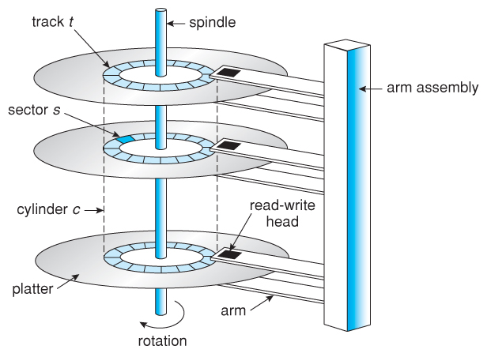
Moving Disk Mechanism

Slide 6
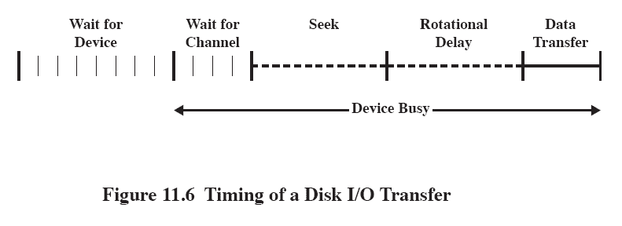
Disk Performance Parameters
The actual details of disk I/O operation depend on many things
A general timing diagram of disk I/O transfer is shown here.
Notes:
The actual details of disk I/O operation depend on the computer system, the operating system, and the nature of the I/O channel and disk controller hardware.
A general timing diagram of disk I/O transfer is shown in Figure 11.6.

Slide 7
Positioning the Read/Write Heads
When the disk drive is operating, the disk is rotating at constant speed.
Track selection involves moving the head in a movable-head system or electronically selecting one head on a fixed-head system.
Notes:
When the disk drive is operating, the disk is rotating at constant speed.
To read or write, the head must be positioned at the desired track and at the beginning of the desired sector on that track.
Track selection involves moving the head in a movable-head system or electronically selecting one head on a fixed-head system.

Slide 8
Disk Performance Parameters
Access Time is the sum of:
Seek time: The time taken by the head assembly to position the itself at the desired track
Rotational delay or rotational latency: The time it takes for the beginning of the sector to reach the head
Transfer Time is the time taken to transfer the data.
Notes:
Access Time is the sum of
Seek Time is the time it takes to position the head at the track.
Rotational delay is the time it takes for the beginning of the sector to reach the head
Once the head is in position, the read or write operation is then performed as the sector moves under the head;
this is the data transfer portion of the operation; the time required for the transfer is the transfer time.

Slide 9
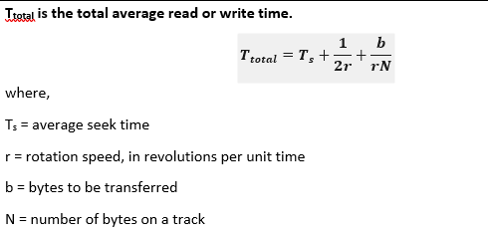
Total R/W Time
b / (rN) = T (Transfer time);
1 / (2r) = Tr (Rotational delay)

Slide 10
Roadmap
Disk Structure
Disk Scheduling
Disk Reliability
Disk Formatting
Boot Block
Bad Block
Notes:
Beginning with a brief discussion of I/O devices and the organization of the I/O functions.
Next examine operating system design issues, including design objectives, and the way in which the I/O function can be structured.
Then I/O buffering is examined;
The next sections of the chapter are devoted to magnetic disk I/O.
We begin by developing a model of disk I/O performance and then examine several techniques that can be used to enhance performance.

Slide 11
Disk Scheduling Algorithms
The list of various disks scheduling algorithm is given below. Each algorithm is carrying some advantages and disadvantages. The limitation of each algorithm leads to the evolution of a new algorithm.
FCFS scheduling algorithm
SSTF (shortest seek time first) algorithm
SCAN scheduling
C-SCAN scheduling
LOOK Scheduling
C-LOOK scheduling

Slide 12
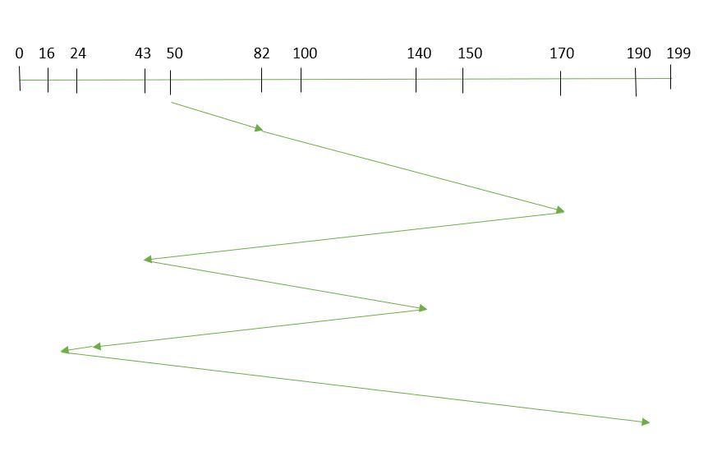
FCFS
FCFS is the simplest of all the Disk Scheduling Algorithms.
In FCFS, the requests are addressed in the order they arrive in the disk queue. Example: Suppose the order of request is- (82,170,43,140,24,16,190) And current position of Read/Write head is : 50

Slide 13
FCFS
So, total seek time: =(82-50)+(170-82)+(170-43)+(140-43)+(140-24) +(24-16)+(190-16) =642
Advantages:
Every request gets a fair chance
No indefinite postponement
Disadvantages:
Does not try to optimize seek time
May not provide the best possible service

Slide 14
SSTF
In SSTF (Shortest Seek Time First), requests having shortest seek time are executed first.
Seek time of every request is calculated in advance in the queue and then they are scheduled according to their calculated seek time.
The request near the disk arm will get executed first.
SSTF is certainly an improvement over FCFS as it decreases the average response time and increases the throughput of system.

Slide 15
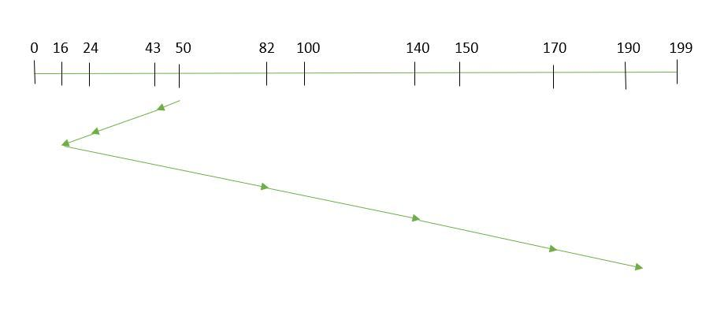
SSTF
Suppose the order of request is- (82,170,43,140,24,16,190) And current position of Read/Write head is : 50

Slide 16
SSTF
So, total seek time:
=(50-43)+(43-24)+(24-16)+(82-16)+(140-82)+(170-40)+(190-170) =208
Advantages:
Average Response Time decreases
Throughput increases
Disadvantages:
Overhead to calculate seek time in advance
Can cause Starvation for a request if it has higher seek time as compared to incoming requests
High variance of response time as SSTF favors only some requests

Slide 17
SCAN
Disk arm moves into a particular direction and services the requests coming in its path and after reaching the end of disk, it reverses its direction and again services the request arriving in its path.
So, this algorithm works as an elevator and hence also known as elevator algorithm.
As a result, the requests at the midrange are serviced more and those arriving behind the disk arm will have to wait.

Slide 18
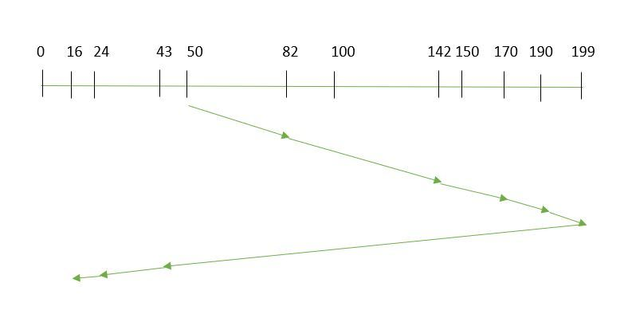
SCAN
Example: Suppose the requests to be addressed are-82,170,43,140,24,16,190. And the Read/Write arm is at 50, and it is also given that the disk arm should move “towards the larger value”.

Slide 19
SCAN
the seek time is calculated as:
=(199-50)+(199-16) =332
Advantages:
High throughput
Low variance of response time
Average response time
Disadvantages:
Long waiting time for requests for locations just visited by disk arm

Slide 20
C-SCAN
In SCAN algorithm, the disk arm again scans the path that has been scanned, after reversing its direction. So, it may be possible that too many requests are waiting at the other end or there may be zero or few requests pending at the scanned area.
These situations are avoided in CSCAN algorithm in which the disk arm instead of reversing its direction goes to the other end of the disk and starts servicing the requests from there.
So, the disk arm moves in a circular fashion and this algorithm is also similar to SCAN algorithm and hence it is known as C-SCAN (Circular SCAN).

Slide 21
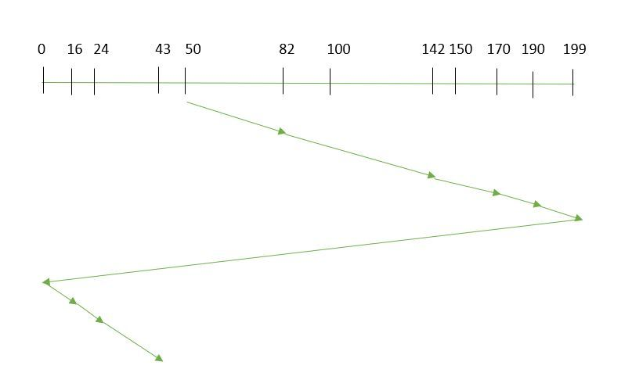
C-SCAN
Example: Suppose the requests to be addressed are-82,170,43,140,24,16,190. And the Read/Write arm is at 50, and it is also given that the disk arm should move “towards the larger value”.

Slide 22
C-SCAN
Seek time is calculated as:
=(199-50)+(199-0)+(43-0) =391
Advantages:
Provides more uniform wait time compared to SCAN

Slide 23
Roadmap
Disk Structure
Disk Scheduling
Disk Reliability
Disk Formatting
Boot Block
Bad Block
Notes:
Beginning with a brief discussion of I/O devices and the organization of the I/O functions.
Next examine operating system design issues, including design objectives, and the way in which the I/O function can be structured.
Then I/O buffering is examined;
The next sections of the chapter are devoted to magnetic disk I/O.
We begin by developing a model of disk I/O performance and then examine several techniques that can be used to enhance performance.

Slide 24
Disk Reliability
The more disks a system has, the greater the likelihood that one of them will go bad at any given time. Hence increasing disks on a system decreases the Mean Time To Failure, MTTF of the system.
If, however, the same data was copied onto multiple disks, then the data would not be lost unless both ( or all ) copies of the data were damaged simultaneously, which is a MUCH lower probability than for a single disk going bad.
More specifically, the second disk would have to go bad before the first disk was repaired, which brings the Mean Time To Repair into play.
This is the basic idea behind disk mirroring, in which a system contains identical data on two or more disks.
Thus, an improvement in Disk Reliability can be done via Redundancy or Mirroring which can be given by RAID (Redundant Array of Inexpensive Disks).

Slide 25
Roadmap
Disk Structure
Disk Scheduling
Disk Reliability
Disk Formatting
Boot Block
Bad Block
Notes:
Beginning with a brief discussion of I/O devices and the organization of the I/O functions.
Next examine operating system design issues, including design objectives, and the way in which the I/O function can be structured.
Then I/O buffering is examined;
The next sections of the chapter are devoted to magnetic disk I/O.
We begin by developing a model of disk I/O performance and then examine several techniques that can be used to enhance performance.

Slide 26
Disk Formatting
Before a disk can be used, it has to be low-level formatted, which means laying down all of the headers and trailers marking the beginning and ends of each sector. Included in the header and trailer are the linear sector numbers, and error-correcting codes, ECC, which allow damaged sectors to not only be detected, but in many cases for the damaged data to be recovered ( depending on the extent of the damage. ) Sector sizes are traditionally 512 bytes, but may be larger, particularly in larger drives.
ECC calculation is performed with every disk read or write, and if damage is detected but the data is recoverable, then a soft error has occurred. Soft errors are generally handled by the on-board disk controller, and never seen by the OS. ( See below. )
Once the disk is low-level formatted, the next step is to partition the drive into one or more separate partitions. This step must be completed even if the disk is to be used as a single large partition, so that the partition table can be written to the beginning of the disk.
After partitioning, then the filesystems must be logically formatted, which involves laying down the master directory information ( FAT table or inode structure ), initializing free lists, and creating at least the root directory of the filesystem. ( Disk partitions which are to be used as raw devices are not logically formatted. This saves the overhead and disk space of the filesystem structure, but requires that the application program manage its own disk storage requirements. )

Slide 27
Roadmap
Disk Structure
Disk Scheduling
Disk Reliability
Disk Formatting
Boot Block
Bad Block
Notes:
Beginning with a brief discussion of I/O devices and the organization of the I/O functions.
Next examine operating system design issues, including design objectives, and the way in which the I/O function can be structured.
Then I/O buffering is examined;
The next sections of the chapter are devoted to magnetic disk I/O.
We begin by developing a model of disk I/O performance and then examine several techniques that can be used to enhance performance.

Slide 28
Boot Block
Computer ROM contains a bootstrap program ( OS independent ) with just enough code to find the first sector on the first hard drive on the first controller, load that sector into memory, and transfer control over to it. ( The ROM bootstrap program may look in floppy and/or CD drives before accessing the hard drive, and is smart enough to recognize whether it has found valid boot code or not. )
The first sector on the hard drive is known as the Master Boot Record, MBR, and contains a very small amount of code in addition to the partition table. The partition table documents how the disk is partitioned into logical disks, and indicates specifically which partition is the active or boot partition.
The boot program then looks to the active partition to find an operating system, possibly loading up a slightly larger / more advanced boot program along the way.
In a dual-boot ( or larger multi-boot ) system, the user may be given a choice of which operating system to boot, with a default action to be taken in the event of no response within some time frame.
Once the kernel is found by the boot program, it is loaded into memory and then control is transferred over to the OS. The kernel will normally continue the boot process by initializing all important kernel data structures, launching important system services ( e.g. network daemons, sched, init, etc. ), and finally providing one or more login prompts. Boot options at this stage may include single-user a.k.a. maintenance or safe modes, in which very few system services are started - These modes are designed for system administrators to repair problems or otherwise maintain the system.

Slide 29
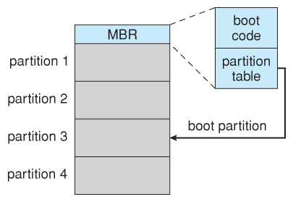
Booting from disk in Windows 2000.

Slide 30
Roadmap
Disk Structure
Disk Scheduling
Disk Reliability
Disk Formatting
Boot Block
Bad Block
Notes:
Beginning with a brief discussion of I/O devices and the organization of the I/O functions.
Next examine operating system design issues, including design objectives, and the way in which the I/O function can be structured.
Then I/O buffering is examined;
The next sections of the chapter are devoted to magnetic disk I/O.
We begin by developing a model of disk I/O performance and then examine several techniques that can be used to enhance performance.

Slide 31
Bad Block
No disk can be manufactured to 100% perfection, and all physical objects wear out over time. For these reasons all disks are shipped with a few bad blocks, and additional blocks can be expected to go bad slowly over time. If a large number of blocks go bad then the entire disk will need to be replaced, but a few here and there can be handled through other means.
In the old days, bad blocks had to be checked for manually. Formatting of the disk or running certain disk-analysis tools would identify bad blocks, and attempt to read the data off of them one last time through repeated tries. Then the bad blocks would be mapped out and taken out of future service. Sometimes the data could be recovered, and sometimes it was lost forever. ( Disk analysis tools could be either destructive or non-destructive. )
Modern disk controllers make much better use of the error-correcting codes, so that bad blocks can be detected earlier and the data usually recovered. ( Recall that blocks are tested with every write as well as with every read, so often errors can be detected before the write operation is complete, and the data simply written to a different sector instead. )
Note that re-mapping of sectors from their normal linear progression can throw off the disk scheduling optimization of the OS, especially if the replacement sector is physically far away from the sector it is replacing. For this reason most disks normally keep a few spare sectors on each cylinder, as well as at least one spare cylinder. Whenever possible a bad sector will be mapped to another sector on the same cylinder, or at least a cylinder as close as possible. Sector slipping may also be performed, in which all sectors between the bad sector and the replacement sector are moved down by one, so that the linear progression of sector numbers can be maintained.
If the data on a bad block cannot be recovered, then a hard error has occurred., which requires replacing the file(s) from backups, or rebuilding them from scratch.

